Slide 1

Data Process Overview
DATA ANALYTICS | FULL-TIME BOOTCAMP

Slide 2

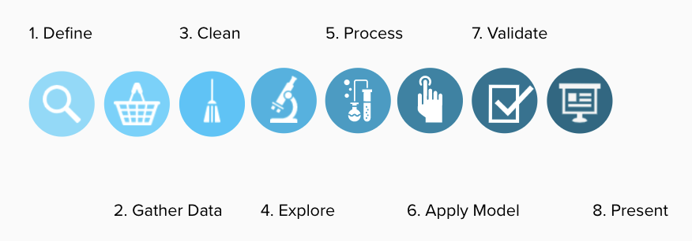
DATA ANALYTICS

Slide 3
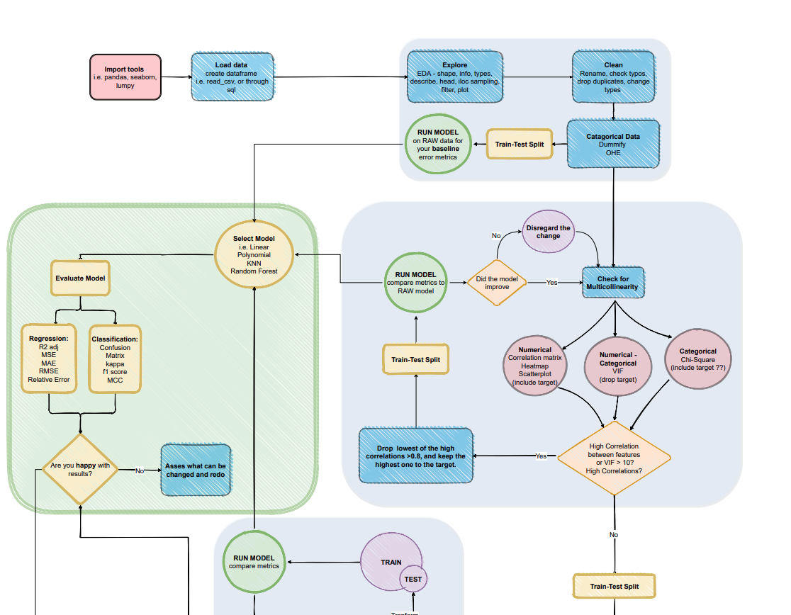
DATA ANALYTICS

Slide 4

🤔
Define the problem

Slide 5
DATA ANALYTICS
How to define the problem?
Which is the problem to solve?
Which is the objective?
What do we need?
Is there a method?

Slide 6
🧺
Gather some data

Slide 7
DATA ANALYTICS
What data do we need?
Which is the necessary data?
Where can we achieve this data?
How can we extract it?
How can we store it?

Slide 8
🧹
Clean the data

Slide 9
DATA ANALYTICS
What information do we want to produce?
What is data cleaning?
What is data wrangling?
How do we do it?
What does ‘data types’ mean?

Slide 10
🛹
Explore, process, build

Slide 11
DATA ANALYTICS
What instrument would make our lives easier?
What is analysis?
Do we need Mathematics?
What is a machine-learning model?
How do we know which is best?

Slide 12
🎁
Validate & Present.

Slide 13
DATA ANALYTICS
What instrument would make our lives easier?
Can we measure the model’s performance?
How do we visualise the results?
Can we automate processes?
Which is the best way to present results?

Slide 14


